Slide 1
Mental Health in the Workplace
Team 2 - Nishi Thapliyal, Stacey Walker, Nathan Roller, Darell Johnson

Slide 2
Why did we choose this topic?
Mental health is an important topic - as important as physical health
Many factors contribute to one’s mental health
Work is a significant portion of many adults’ lives and can significantly impact one’s mental health
Within the workplace, there are factors such as remote work setups, mental health programs, ease of taking leave, etc. that can impact mental health
The dataset we are using is from a 2014 survey that measures attitudes toward mental health and the frequency of mental health disorders in the workplace
https://www.kaggle.com/datasets/osmi/mental-health-in-tech-survey/data

Slide 3
Questions we want to answer
Does remote vs. onsite work affect mental health in the workplace?
How does mental health impact work performance?
Is there a relationship between the level of difficulty of taking leave and mental health outcomes?
What is the impact of company size on mental health?
Are mental health programs implemented by companies effective?
Is the number of people seeking treatment randomly distributed?
Is there a relationship between age and seeking treatment?
Are there differences in mental health treatment seeking behavior between self employed and employed individuals?
Is there a relationship between the family history of mental health and the behavior of those seeking mental health treatment?

Slide 4
Cleaning up the dataset
Filtered by participants who live in the United States
For the “self-employed” category, NA values were converted into “No”
What are some limitations of this dataset?
Various factors not listed in the survey may have significant impacts on the responses, such as state laws/accessibility/awareness regarding mental health
Other personal factors that would affect a person’s decision to seek mental health treatment (family situation/responsibilities, income, etc.)
Does not account for the most recent changes, such as the current number of remote/hybrid workers and new focus on mental healthcare

Slide 5
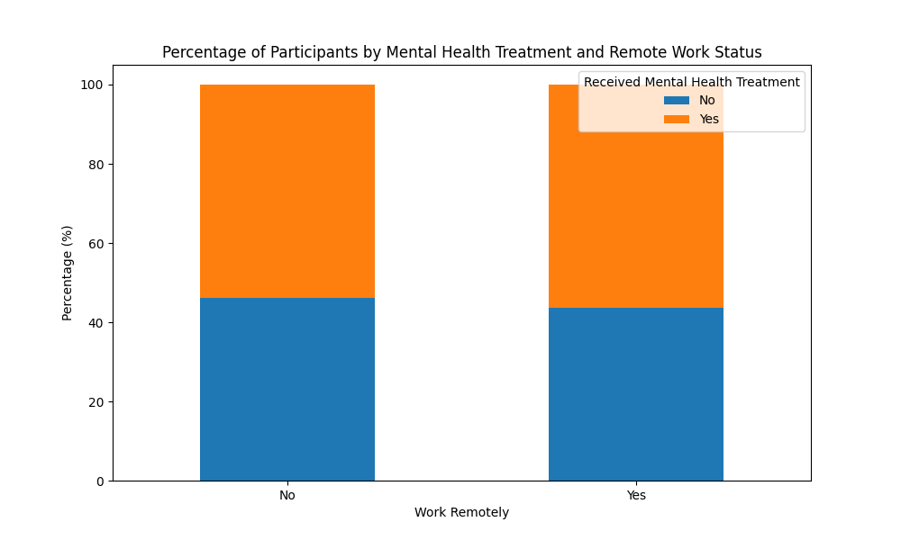
Relationship between remote work and mental health in the workplace

Slide 6
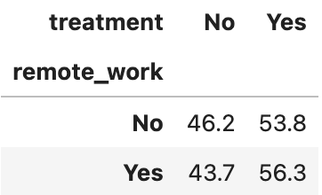
Relationship between remote work and mental health in the workplace
The percentage of participants who seek mental health treatment are ~ equal between those who work remotely and those who do not.
Based on this data set, working remotely is not a major factor that affects people seeking mental health treatment or not.

Slide 7
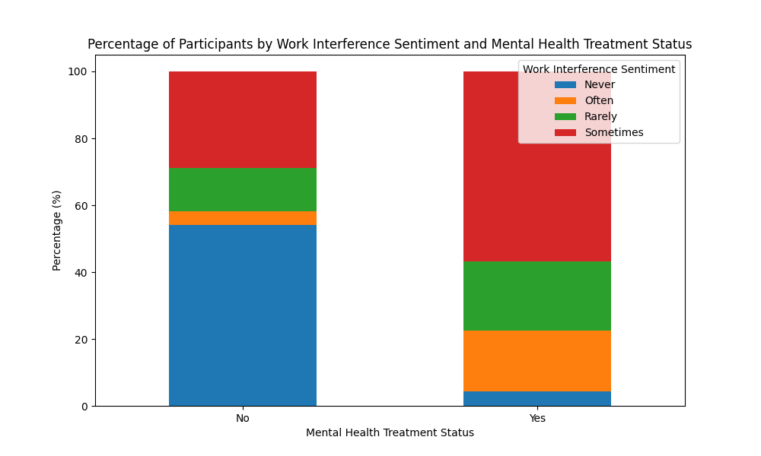
Impact of mental health on work performance

Slide 8
Impact of mental health on work performance
Of those who do not seek mental health treatment:
~50% report that their mental health does not interfere with work
Good mental health or lack of awareness
Of those who do seek mental health treatment:
~55% report that mental health sometimes interferes with work. Seeking mental health treatment may increase awareness
The next largest groups (~20% each) report that mental health either rarely or often interferes with work. This may be due to the effectiveness of mental health treatments or constitutes the reason for getting treatment, respectively.

Slide 9
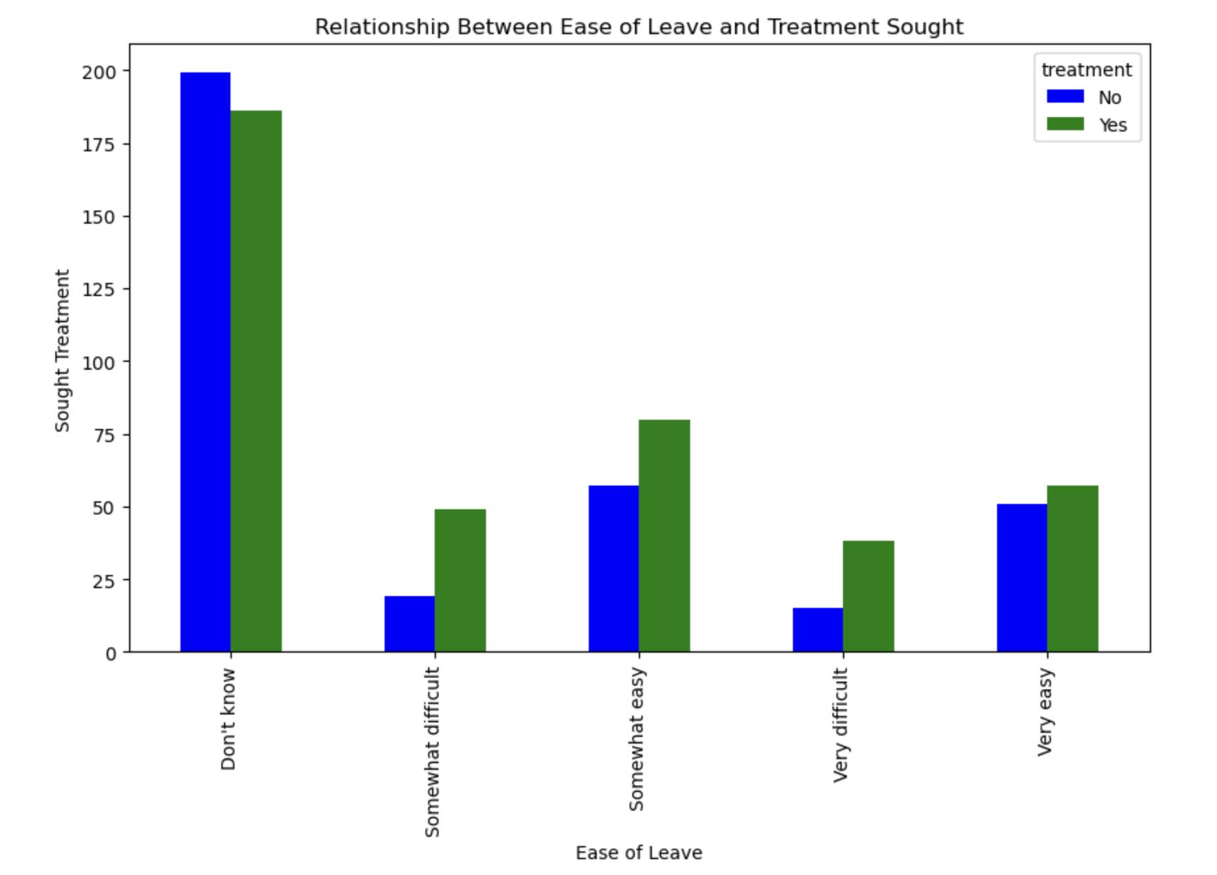
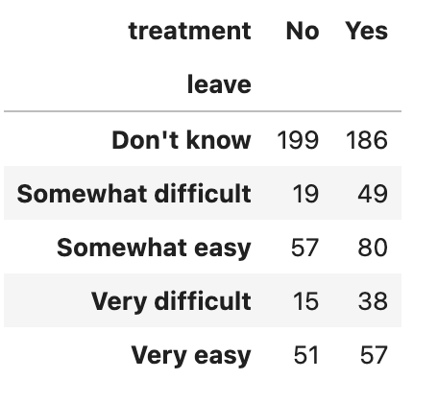
Relationship Between Ease of Leave and Mental Health Treatment

Slide 10
Summary of Findings:
Other than those who responded “Don’t Know” (which had less people answer “no” than “yes”), every group had more people taking leave than not, regardless of difficulty
There were less respondents overall who qualified their company’s policy as difficult than easy
Considerations:
Is the lack of knowledge about policies because of…
Poor communication from the company?
Lack of interest/need from the employee(s)?
If “somewhat/very easy/difficult” are viewed together, far more people consider feel it is easy to take leave for mental health than people who feel it is difficult

Slide 11
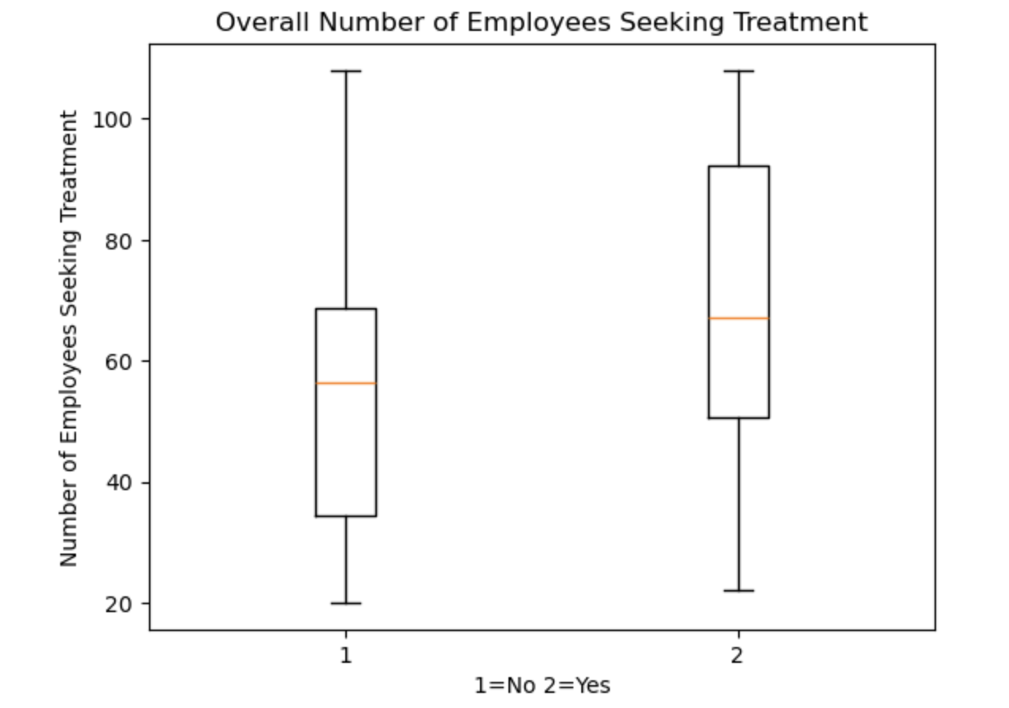
Overall Number of Employees Seeking Treatment
Degrees of Freedom: 5
Mean (No): 56.8
Mean (Yes): 68.3
Standard Dev (No): 28.87
Standard Dev (Yes): 29.52

Slide 12
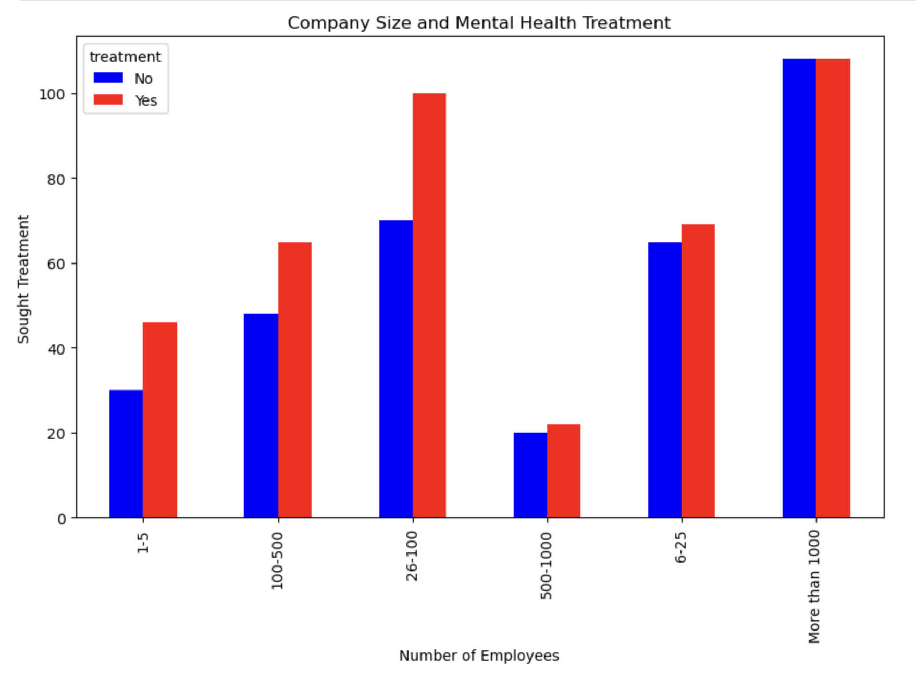
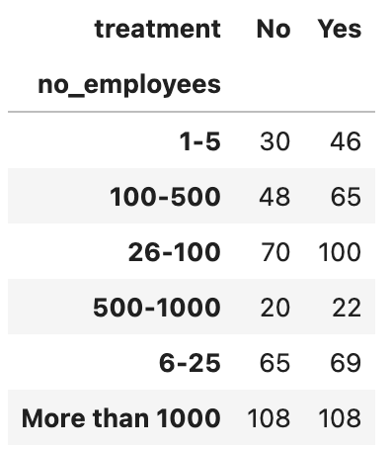
Relationship Between Company Size and Mental Health Treatment

Slide 13
Summary of Findings:
Employees are willing to seek mental health treatment more often than not, regardless of the size of the company
One exception: companies with 1000+ employees had an even number of people who said yes and no to seeking mental health treatment
More willingness from people who work for smaller companies
Why? Communication could be the reason
Larger companies are more likely to send an email or provide a handout of policies, whereas smaller companies might have a more personal means of letting employees know about the policies
Closer relationships make it easier to take leave
Limitations of the data:
Companies with 500-1000 employees are underrepresented in this dataset
Despite the underrepresentation, the results follow the same trend as the other populations
Many unknowns about the companies, other than their sizes

Slide 14
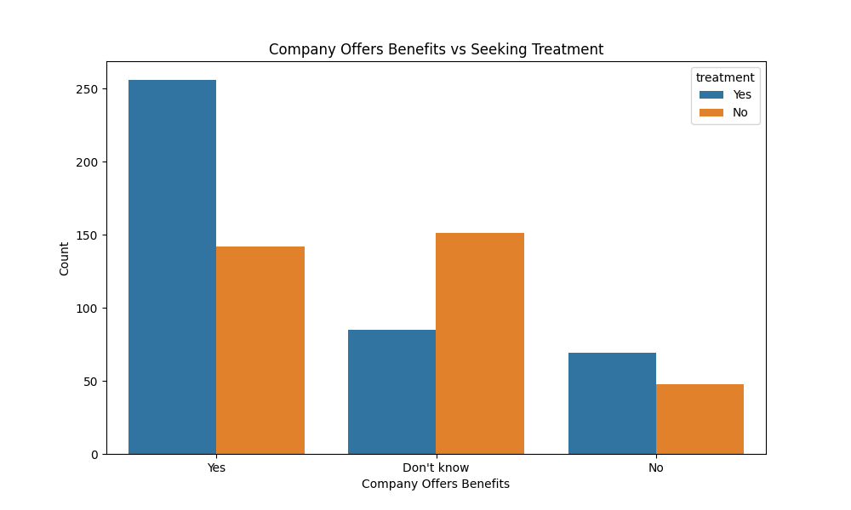
Companies Offering Benefits and Employees Seeking Treatment
Company Offers Benefits
Employee Seeks Treatment

Slide 15
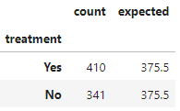

Randomness of Seeking Treatment
Null hypothesis: No statistical significance exists in the distribution of people seeking treatment and not seeking treatment.
Results:
REJECT the null - With 95% confidence, the number of people who seek treatment in this study is NOT randomly distributed.
Notes:
Since the chi square value of 6.34 exceeds the critical value of 3.84, we conclude that the results are statistically significant.

Slide 16
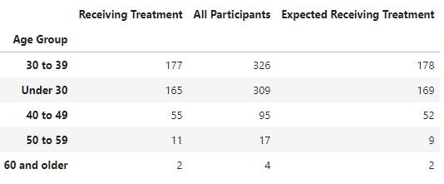

Relationship Between Age and Seeking Treatment
Null hypothesis: There is no significant association between age and seeking treatment for mental health.
Results:
Do NOT reject the null - With 95% confidence, we can say there is no significant association between age and seeking treatment for mental health.
Notes:
Since the chi square value of 0.72 does not exceed the critical value of 9.49, we conclude that the results are NOT statistically significant.

Slide 17

Seeking Help
Are there differences in mental health treatment seeking behavior between self employed and employed individuals?
Is there a relationship between the family history of mental health and the behavior of those seeking mental health treatment?

Slide 18
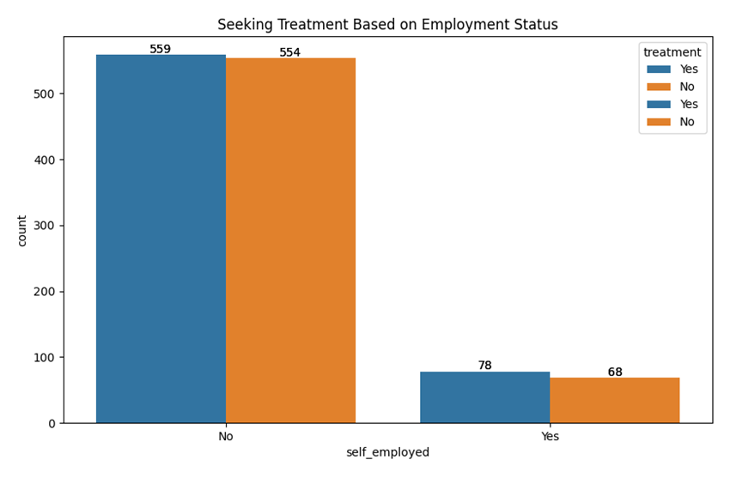
Employed Vs Self-Employed
Primary Hypothesis:
Self-employed individuals are less likely to seek mental health treatment compared to employed individuals.
Time constraints
Resource limitations
Conclusion:
This indicates that employment status alone may not be a strong determinant of mental health treatment-seeking behavior.

Slide 19
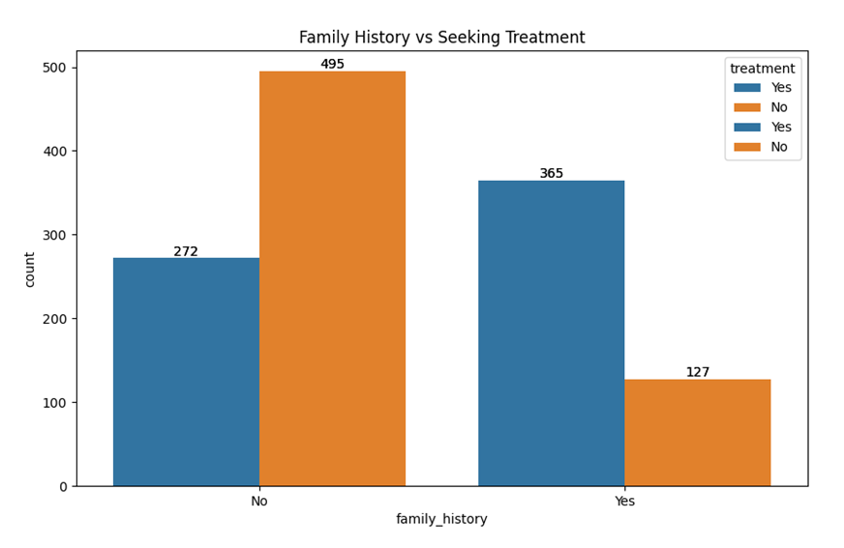
Family History and Seeking Help
Primary Hypothesis: Individuals with a family history of mental health issues are more likely to seek mental health treatment compared to those without such a history.
Awareness
Concern
Experience

Slide 20
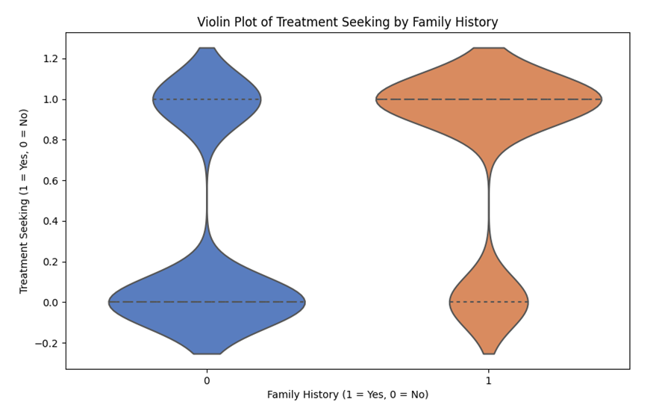
Family History and Seeking Help (cont.)
Shows a higher density of treatment-seeking behavior among individuals with a family history of mental health issues.

Slide 21
Statistical Analysis
Hypotheses
Null Hypothesis (H₀): There is no difference in the mean proportion of seeking treatment between individuals with and without a family history of mental health issues. (Reject)
Alternative Hypothesis (H₁): There is a significant difference in the mean proportion of seeking treatment between individuals with and without a family history of mental health issues.
Group 1 (With Family History):
Mean proportion seeking treatment: 74.2%
Group 2 (Without Family History):
Mean proportion seeking treatment: 35.5%
Family history of mental health issues is an important factor in whether individuals seek treatment.
T-statistic: 14.755
P-value: 3.919e-45

Slide 22
Summary
Employment Status and Treatment Seeking: There is no substantial difference in mental health treatment-seeking behavior between self-employed and employed individuals based on the provided data.
Family History and Treatment Seeking: Individuals with a family history of mental health issues are significantly more likely to seek mental health treatment compared to those without such a history, confirming the hypothesis.
The findings show that individuals with a family history are more proactive in seeking mental health treatment, whereas employment status does not significantly determine treatment-seeking behavior.

